Slide 1
Development of a Card Game Management Application within a Real & Virtual Environment
Realized by:
Boris LENG
Bastien CARRE
Lyvia LOUISIUS
Andrei BROUSSILLON
Supervising professors:
Catherine MARECHAL
Elizabeth COLIN
Lamine BOUGUEROUA

Slide 2
Introduction
Blue Weasel
This is a revolution !!!

Slide 3
Contents
Presentation of the project
State Of The Art
Functional requirements
Gantt Chart & Work division
Conclusion

Slide 4
Presentation of the project
Goal of the project
Chosen tools (Java language, C++, …)
Available equipment
Various tasks
Problems encountered

Slide 5
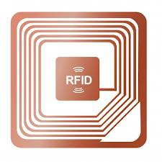
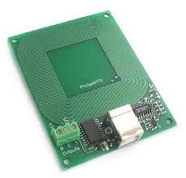
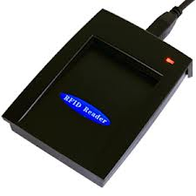
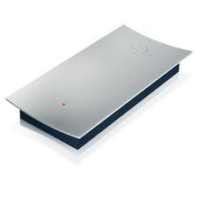
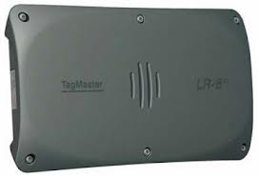
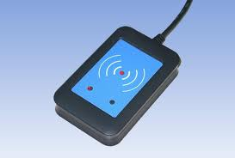
State Of The Art
Antenna
Circuitry

Slide 6
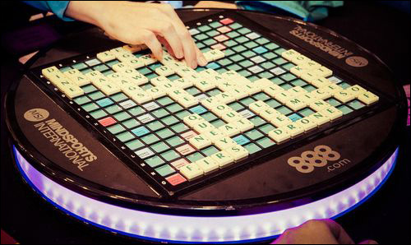
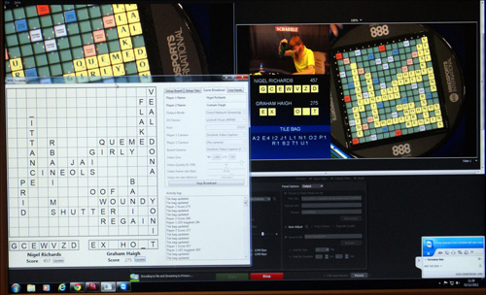
State Of The Art
Every tile has a passive 13.56 MHz RFID tag
225 squares, under each of which there is a single antenna
For antenna holders, each antenna could read the tag of a tile placed within approximately 4 millimeters of that antenna.

Slide 7
Functional requirements
Description:
Overview
Detailed functionalities:
Siging in
Beginning
Scanning
Playing
Ending
History

Slide 8
Functional requirements
Description:
Ergonomics
Game Table Application Ergonomics
Appendix n°1

Slide 9
Functional requirements
Description:
Ergonomics
Tablet App Ergonomics
Appendix n°2

Slide 10
Functional requirements
Description:
Case of the Belote Game:
Preparation
Dealing
Bidding
End of dealing
Playing
Scoring

Slide 11
Functional requirements
Description:
Possible improvements:
Adaptation of Blue Weasel for other card games with possibly more than four players
Better use of the RFID technology with more recent card readers
Putting Blue Weasel on the cloud

Slide 12
Conclusion
Feasibility
Tasks done and remaining tasks
Remaining time before the deadline
Possible evolution

Slide 13

Thank you for your attention!

